Slide 1
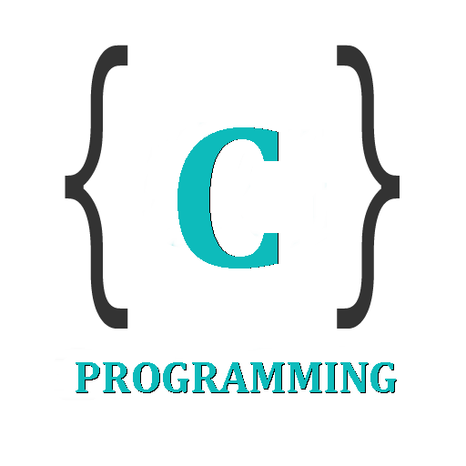

IT 105: Introduction to Programming
Dr. Manish Khare
Dr. Saurabh Tiwari
Lecture 8

Slide 2
Case Control Instruction
  In real life we are often faced with situations where we are required to make a choice between a number of alternatives rather than only one or two.
  C provides a special control statement that allows us to handle such cases effectively; rather than using a series of if statements.

Slide 3
Decision Using Switch
The control statement that allows us to make a decision from the number of choices is called a switch, or more correctly a switch-case-default, since these three keywords go together to make up the control statement
switch ( integer expression )
{
case constant 1 :
do this ;
case constant 2 :
do this ;
case constant 3 :
do this ;
default :
do this ;
}

Slide 4
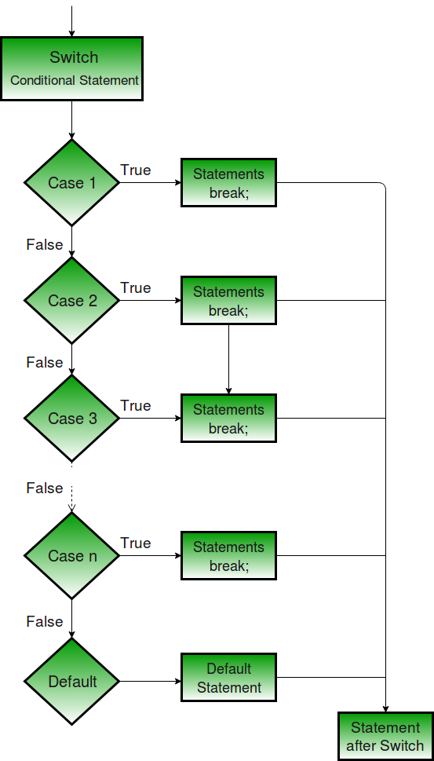
Decision Using Switch

Slide 5
The integer expression following the keyword switch is any C expression that will yield an integer value.
It could be an integer constant like 1, 2 or 3, or an expression that evaluates to an integer.
The keyword case is followed by an integer or a character constant.
Each constant in each case must be different from all the others.
The “do this” lines in the above form of switch represent any valid C statement.

Slide 6
What happens when we run a program containing a switch?
  First, the integer expression following the keyword switch is evaluated.
  The value it gives is then matched, one by one, against the constant values that follow the case statements.
  When a match is found, the program executes the statements following that case, and all subsequent case and default statements as well.
  If no match is found with any of the case statements, only the statements following the default are executed

Slide 7
main( )
{
int i = 2 ;
switch ( i )
{
case 1 :
printf ( "I am in case 1 \n" ) ;
case 2 :
printf ( "I am in case 2 \n" ) ;
case 3 :
printf ( "I am in case 3 \n" ) ;
default :
printf ( "I am in default \n" ) ;
}
}
The output of this program would be
I am in case 2
I am in case 3
I am in default
Surprised!!

Slide 8
The output is definitely not what we expected!
We didn’t expect the second and third line in the above output.
The program prints case 2 and 3 and the default case. Well, yes.
We said the switch executes the case where a match is found and all the subsequent cases and the default as well.

Slide 9
If you want that only case 2 should get executed, it is upto you to get out of the switch then and there by using a break statement.

Slide 10
main( )
{
int i = 2 ;
switch ( i )
{
case 1 :
printf ( "I am in case 1 \n" ) ;
break ;
case 2 :
printf ( "I am in case 2 \n" ) ;
break ;
case 3 :
printf ( "I am in case 3 \n" ) ;
break ;
default :
printf ( "I am in default \n" ) ; } }
The output of this program would be:
I am in case 2

Slide 11
The previous example shows how this is done.
Note that there is no need for a break statement after the default, since the control comes out of the switch anyway

Slide 12
Few tips about usage of switch
The program in previous slides may give you an impression that cases in a switch must be arranged in ascending order – 1,2,3, and default.
In fact, you can put the cases in any order

Slide 13
main( )
{
int i = 22 ;
switch ( i )
{
case 121 :
printf ( "I am in case 121 \n" ) ;
break ;
case 7 :
printf ( "I am in case 7 \n" ) ;
break ;
case 22 :
printf ( "I am in case 22 \n" ) ;
break ;
default :
printf ( "I am in default \n" ) ; } }
The output of this program would be:
I am in case 22

Slide 14
You are also allowed to use char values in case and switch as shown in the following program

Slide 15
main( )
{
char i = ‘x’ ;
switch ( i )
{
case ‘v’ :
printf ( "I am in case v \n" ) ;
break ;
case ‘a’ :
printf ( "I am in case a \n" ) ;
break ;
case ‘x’ :
printf ( "I am in case x \n" ) ;
break ;
default :
printf ( "I am in default \n" ) ; } }
The output of this program would be:
I am in case x
In fact here when we use ‘v’, ‘a’, ‘x’ they are actually replaced by the ASCII values (118, 97, 120) of these character constants

Slide 16
At times we may want to execute a common set of statements for multiple cases.
How this can be done is shown in the following example

Slide 17
main( )
{
char ch ;
printf ( "Enter any of the alphabet a, b, or c " ) ;
scanf ( "%c", &ch ) ;
switch ( ch )
{ case 'a’ :
case 'A’ :
printf ( "a as in ashar" ) ;
break ;
case 'b’ :
case 'B’ :
printf ( "b as in brain" ) ;
break ;
case 'c’ :
case 'C’ :
printf ( "c as in cookie" ) ;
break ;
default :
printf ( "wish you knew what are alphabets" ) ;
}
}

Slide 18
Here, we are making use of the fact that once a case is satisfied the control simply falls through the case till it doesn’t encounter a break statement.
That is why if an alphabet a is entered the case ‘a’ is satisfied and since there are no statements to be executed in this case the control automatically reaches the next case i.e. case ‘A’ and executes all the statements in this case.

Slide 19
Even if there are multiple statements to be executed in each case there is no need to enclose them within a pair of braces (unlike if, and else).
Every statement in a switch must belong to some case or the other. If a statement doesn’t belong to any case the compiler won’t report an error. However, the statement would never get executed.
For example, in the following program the printf( ) never goes to work.

Slide 20
If we have no default case, then the program simply falls through the entire switch and continues with the next instruction (if any,) that follows the closing brace of switch.
The break statement when used in a switch takes the control outside the switch.
  However, use of continue will not take the control to the beginning of switch as one is likely to believe.

Slide 21
In principle, a switch may occur within another, but in practice it is rarely done. Such statements would be called nested switch statements.
The switch statement is very useful while writing menu driven programs.

Slide 22
We can check the value of any expression in a switch.
  Thus the following switch statements are legal.
    switch ( i + j * k )
    switch ( 23 + 45 % 4 * k )
    switch ( a < 4 && b > 7 )
  Expressions can also be used in cases provided they are constant expressions.
    Thus case 3 + 7 is correct, however, case a + b is incorrect.

Slide 23
Is switch a replacement for if? Yes or No
Yes, because it offers a better way of writing programs as compared to if, and no because in certain situations we are left with no choice but to use if.
The disadvantage of switch is that one cannot have a case in a switch which looks like:
  case i <= 20 :
The advantage of switch over if is that it leads to a more structured program and the level of indentation is manageable, more so if there are multiple statements within each case of a switch.

Slide 24
switch Versus if-else Ladder
There are some things that you simply cannot do with a switch.
These are:
  A float expression cannot be tested using a switch
  Cases can never have variable expressions (for example it is wrong to say case a +3 : )
  Multiple cases cannot use same expressions.
Thus the following switch is illegal:

Slide 25
switch ( a )
{
case 3 :
...
case 1 + 2 :
...
}

Slide 26
Program-
Convert the if-else program to switch-case-default
main( )
{
int m1, m2, m3, m4, m5, per ;
printf ("Enter marks in five subjects ") ;
scanf ( "%d %d %d %d %d", &m1, &m2, &m3, &m4, &m5 ) ;
per = ( m1 + m2 + m3 + m4 + m5 ) / 5 ;
if ( per >= 60 )
printf ( "First division" ) ;
if ( ( per >= 50 ) && ( per < 60 ) )
printf ( "Second division" ) ;
if ( ( per >= 40 ) && ( per < 50 ) )
printf ( "Third division" ) ;
if ( per < 40 )
printf ( "Fail" ) ;
} /* main */

Slide 27
What would be the output
main( )
{
char suite = 3 ;
switch ( suite )
{
case 1 :
printf ( "\nDiamond" ) ;
case 2 :
printf ( "\nSpade" ) ;
default :
printf ( "\nHeart") ;
}
printf ( "\nI thought one wears a suite" ) ;
}
Notes:
Heart
I thought one wears a suite

Slide 28
What would be the output
main( )
{
int k, j = 2 ;
switch ( k = j + 1 )
{
case 0 :
printf ( "\nTailor") ;
case 1 :
printf ( "\nTutor") ;
case 2 :
printf ( "\nTramp") ;
default :
printf ( "\nPure Simple Egghead!" ) ;
}
}
Notes:
Pure Simple Egghead

Slide 29
What would be the output
main( )
{
int k ;
float j = 2.0 ;
switch ( k = j + 1 )
{
case 3 :
printf ( "\nTrapped" ) ;
break ;
default :
printf ( "\nCaught!" ) ;
}
}
Notes:
Pure Simple Egghead

Slide 30
What would be the output
main( )
{
int ch = 'a' + 'b’ ;
switch ( ch )
{
case 'a’ :
case 'b’ :
printf ( "\nYou entered b" ) ;
case 'A’ :
printf ( "\na as in ashar" ) ;
case 'b' + 'a’ :
printf ( "\nYou entered a and b" ) ;
}
}
Notes:
You entered a and b

Slide 31
main( )
{
int temp ;
scanf ( "%d", &temp ) ;
switch ( temp )
{
case ( temp <= 20 ) :
printf ( "\nOoooooohhhh! Damn cool!" ) ;
case ( temp > 20 && temp <= 30 ) :
printf ( "\nRain rain here again!" ) ;
case ( temp > 30 && temp <= 40 ) :
printf ( "\nWish I am on Everest" ) ;
default :
printf ( "\nGood old nagpur weather" ) ;
}
}
Notes:
You entered a and b

Slide 32
main( )
{
float a = 3.5 ;
switch ( a )
{
case 0.5 :
printf ( "\nThe art of C" ) ;
break ;
case 1.5 :
printf ( "\nThe spirit of C" ) ;
break ;
case 2.5 :
printf ( "\nSee through C" ) ;
break ;
case 3.5 :
printf ( "\nSimply c" ) ;
}
}
Notes:
You entered a and b

Slide 33
main( )
{
int a = 3, b = 4, c ;
c = b – a ;
switch ( c )
{
case 1 || 2 :
printf ( "God give me an opportunity to change things" ) ;
break ;
case a || b :
printf ( "God give me an opportunity to run my show" ) ;
break ;
}
}
Notes:
You entered a and b

Slide 34
Write a menu driven program which has following options:
  1. Sum of all the numbers
  2. Prime or not
  3. Odd or even
Make use of switch statement.
https://ideone.com/CP6cYU

Slide 35
Exercise?
Write a program that takes name of animals (dog, cat, mouse) as input, and subsequently print sound they produce while barking.
- Create using if-else
- Create using switch-case-default

Slide 36
Home Assignment
Write a program which to find the grace marks for a student using switch. The user should enter the class obtained by the student and the number of subjects he has failed in.
  − If the student gets first class and the number of subjects he failed in is greater than 3, then he does not get any grace. If the number of subjects he failed in is less than or equal to 3 then the grace is of 5 marks per subject.
  − If the student gets second class and the number of subjects he failed in is greater than 2, then he does not get any grace. If the number of subjects he failed in is less than or equal to 2 then the grace is of 4 marks per subject.
  − If the student gets third class and the number of subjects he failed in is greater than 1, then he does not get any grace. If the number of subjects he failed in is equal to 1 then the grace is of 5 marks per subject
Solve using both if-else & switch-case-default

